Slide 1
Summary of runs and requests for CIE review of EBS flatfish
For yellowfin sole
Potential short-term requests:
Constant fishery selectivity
Start the model in 1982, ignore historical catches and other data
Examine sex-specific natural mortality
Time-varying selectivity for survey (if possible) and relationship w/ fishery.
Longer term:
size-based selectivity and potential interactions with growth changes
Examine plus-group
Retrospective patterns with full model for survey catchability
Age-specific natural mortality (e.g., Lorenzen) might be considered (but since fishery ages mostly older, may not matter so much)

Slide 2
YFS Fits to survey
For requested models

Slide 3
YFS Female spawning biomass estimates
For requested models

Slide 4
Variable fishery selectivity

Slide 5
Constant fishery selectivity

Slide 8
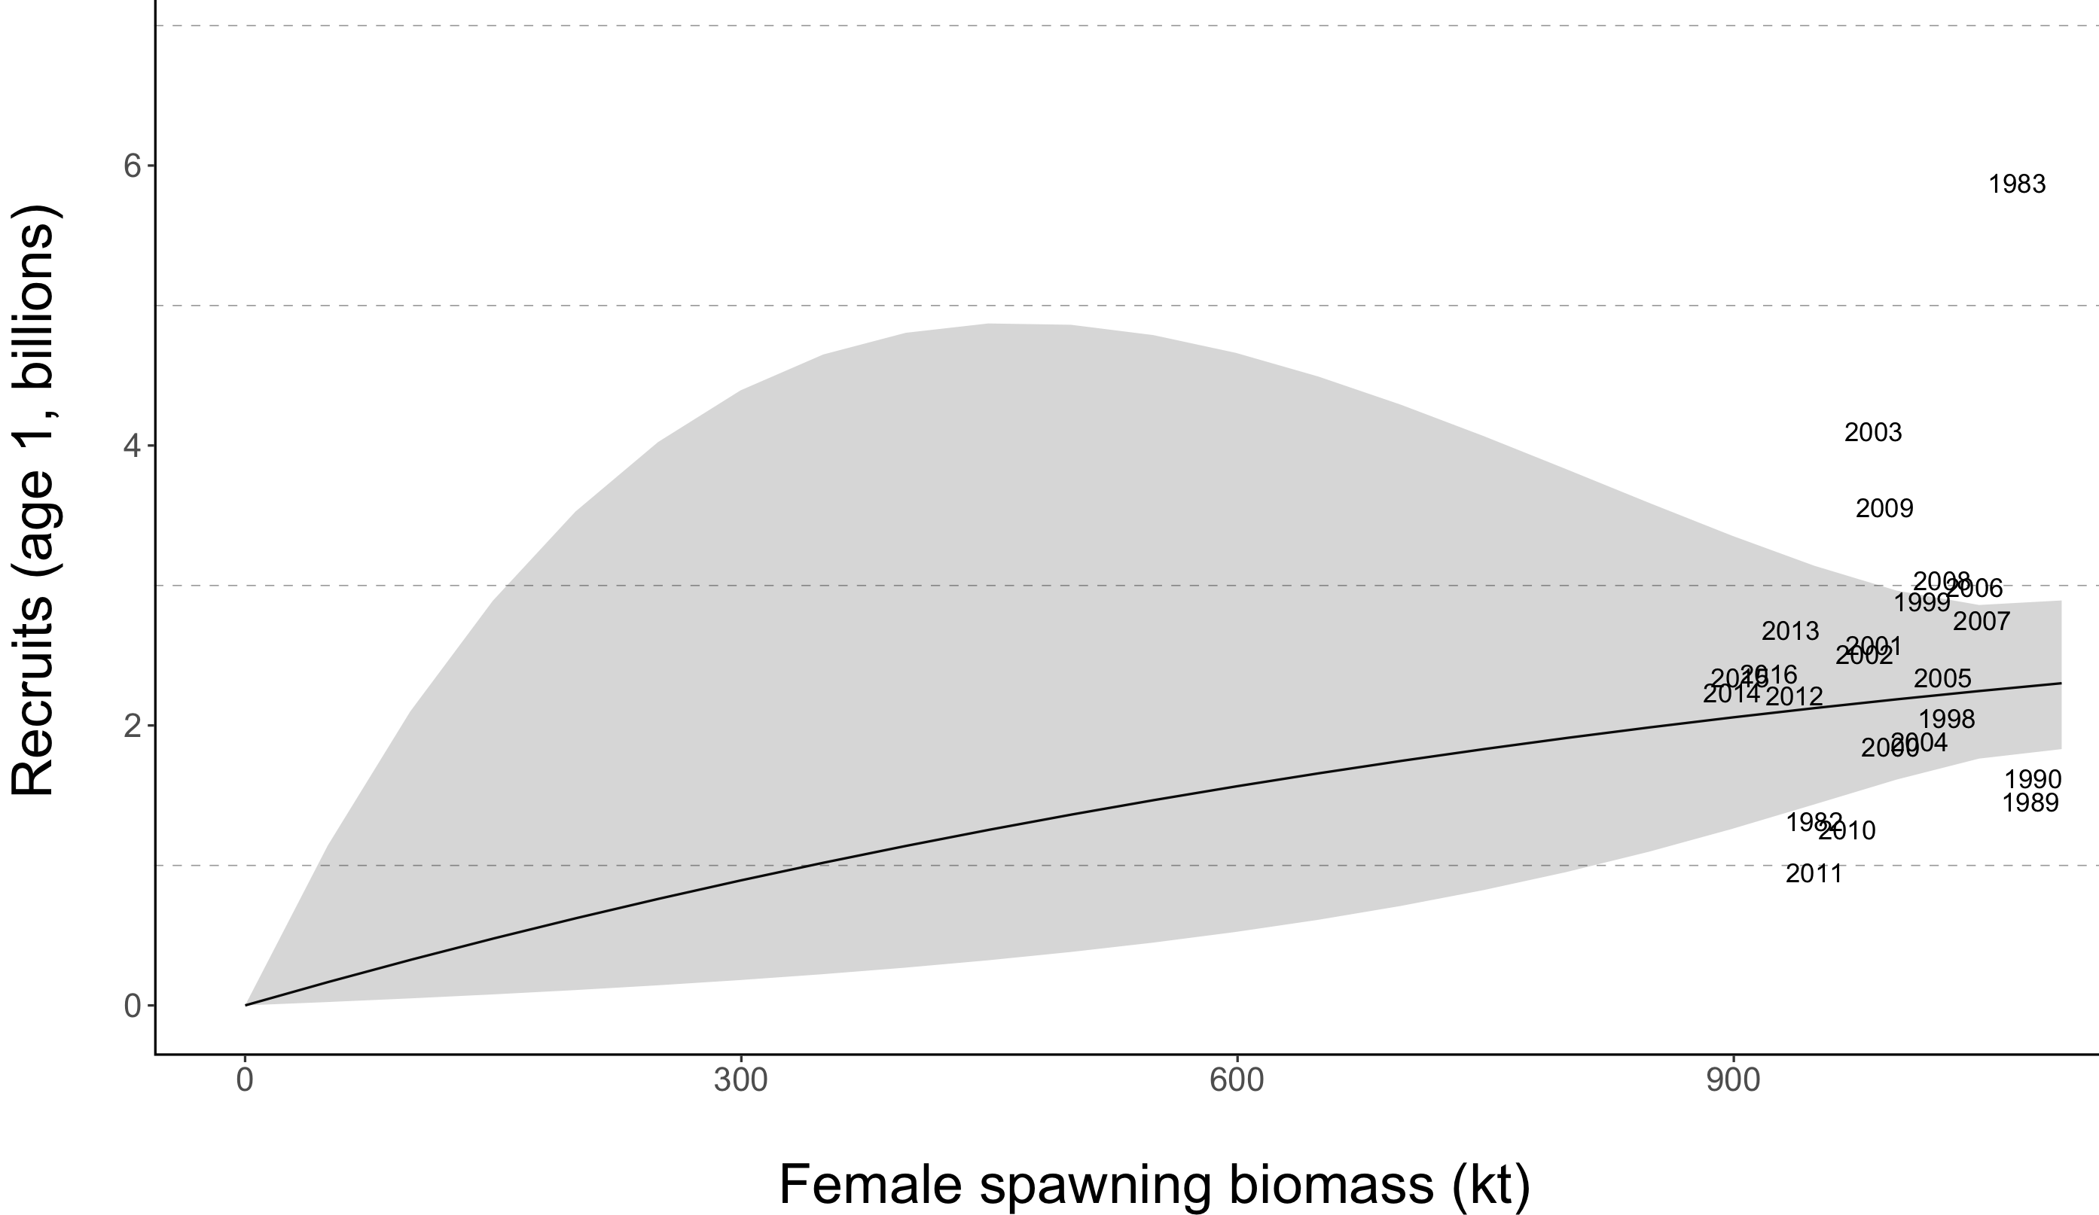

Slide 9
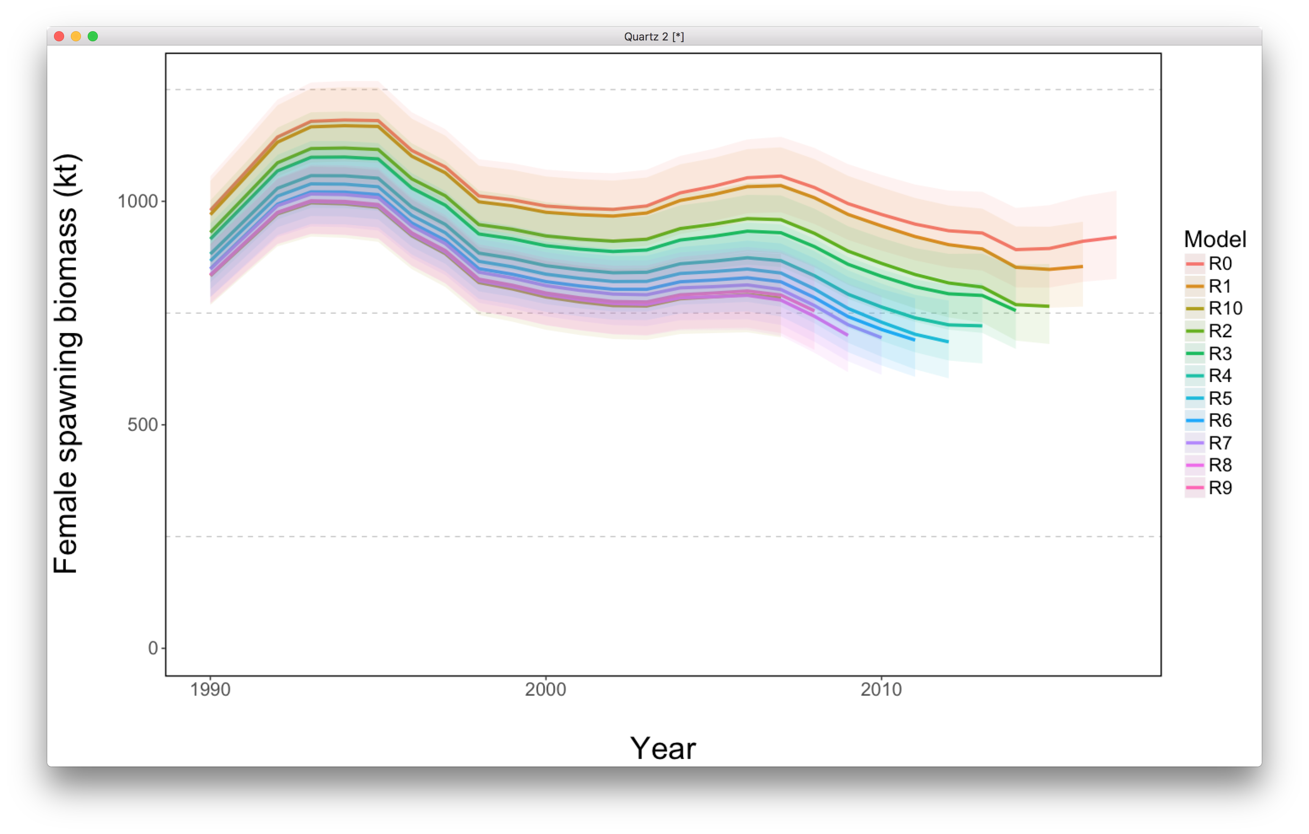
Retrospective runs for “new base””

Slide 11
Rock sole
Examine posterior marginal distributions

Slide 12
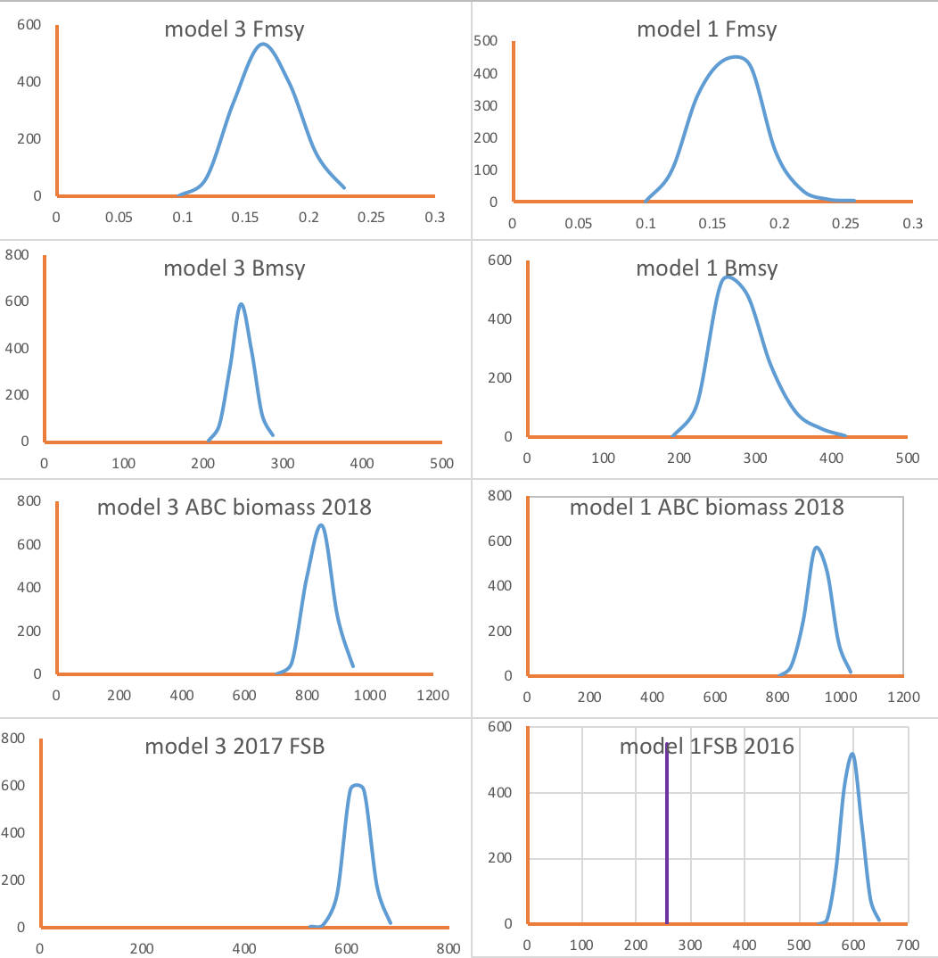
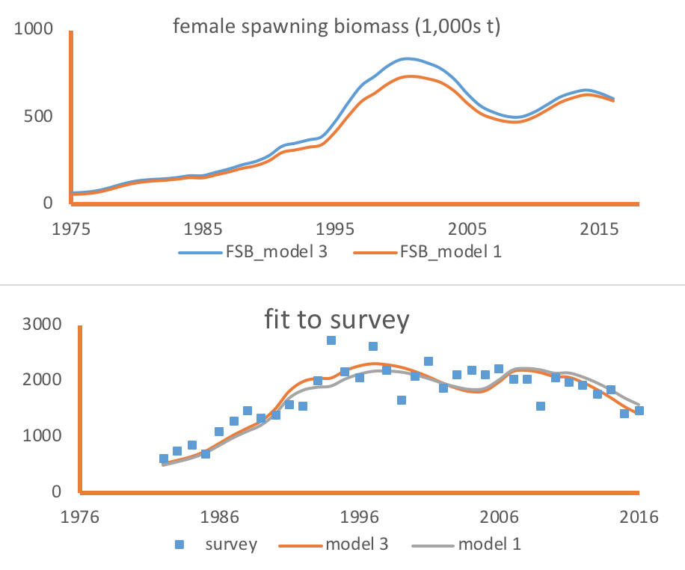
N Rock sole
Posterior marginal distributions

Slide 13
Alaska plaice

Slide 14
Alaska plaice

Slide 15
Alaska plaice

